Slide 1

SMART GROCERY LIST GENERATOR
Team Members: 1. Surya Praveen Adivi
2. Bahuroop Chakravarthy paaladugu
3. Roshini Erukulla

Slide 2
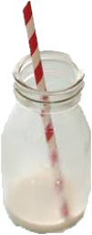
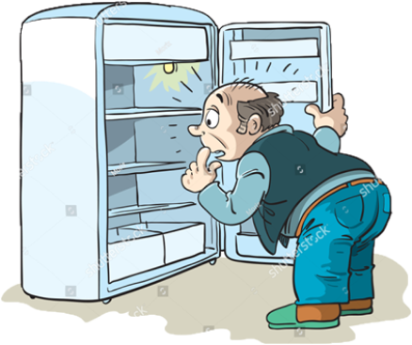
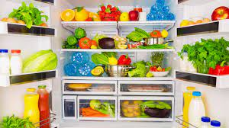
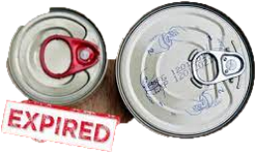
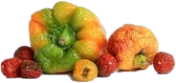
Motivation
Hungry?? Come Let's check our Refrigerator!!

Slide 3
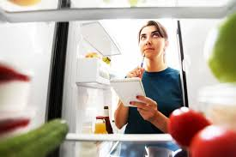
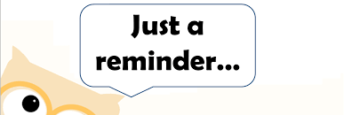
We explicitly need to go and find what there in our fridge and what’s about to empty
We need ……….

Slide 4

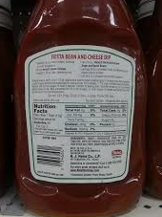
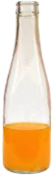
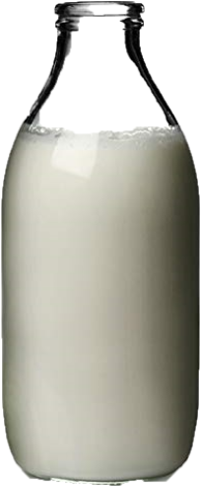

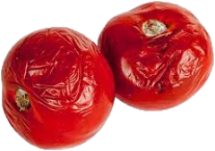
Methodology

Slide 5
Planning
Quality Check
Groceries
Rotten??
Finished?
Scan Refrigerator for Items
Quantity Check
Bottle / Carton
Expired??
Finished?
Expiry Check
Pouches
Expired

Slide 6
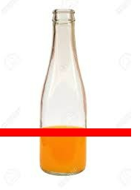
Quantity Check
Input
Output
height filled: 80
std_height : 220.0
amount of bottle filled: 36.3%
import cv2
Library Used:

Slide 7
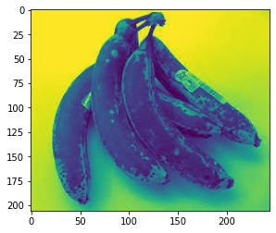
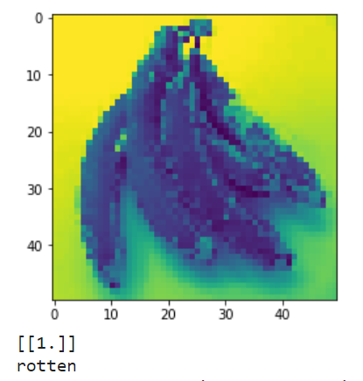
import tensorflow as tf
Quality Check
Input
Output
Detected Rotten
import tensorflow
Library Used:

Slide 8
Demo

Slide 9
Challenges faced
Data Availability: In order to train the CNNs, a sizable dataset of tagged photos of food and drink products is required. It can be costly and time-consuming to gather this information.
Users' input data may have varying levels of quality, requiring manual corrections such as spelling mistakes, abbreviations, or missing information before it can be used.
User dietary preferences and restrictions: These factors can increase the complexity of the recommendation engine and must be considered by the system.

Slide 10
Error Analysis
By changing the epoch values, we examined how does dropout rate affect CNN performance? We can add the dropout rate to the build_model() function and train and evaluate the model with different dropout rates. Each experiment's training and validation accuracy and loss are plotted and compared to see how the dropout rate affects the model's performance.
We have changed the filters value of CNN. As the number of filters rises, the model performs better on the training set but overfits and performs worse on the validation set. This shows that too many filters may cause overfitting, while too few may cause underfitting.
The model is trained and evaluated using 5-fold cross-validation. Performance metrics such asaccuracy, precision, recall, and F1 score are calculated for each split, and the confusion matrix is plotted for each split. We can clearly see the difference in the confusion matrix for each split.

Slide 11
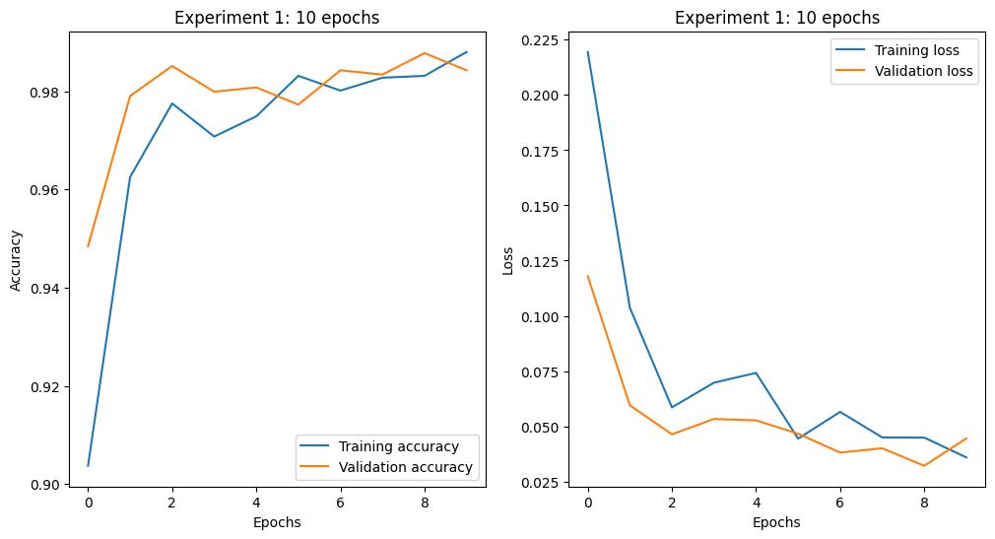
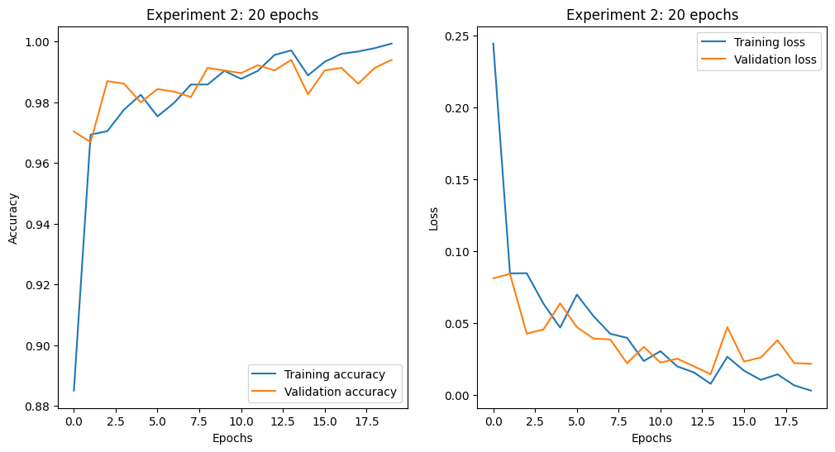
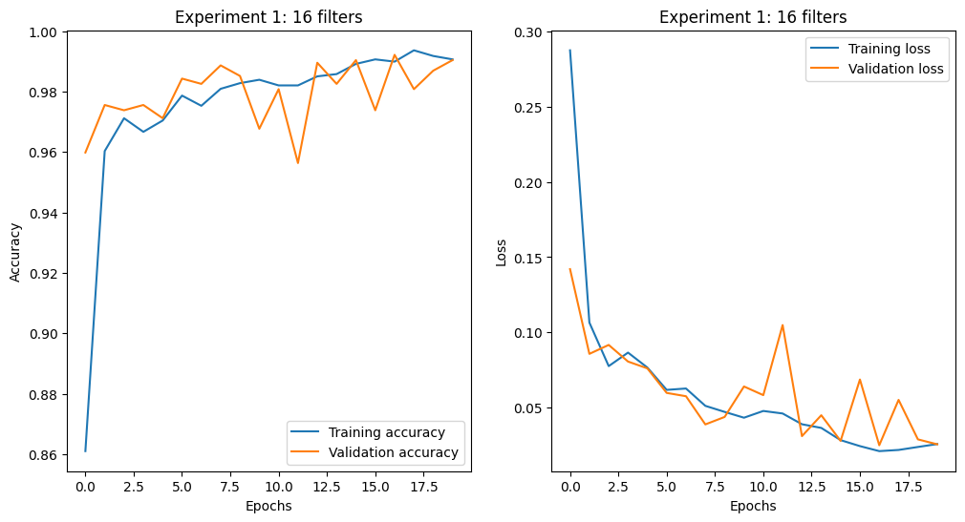
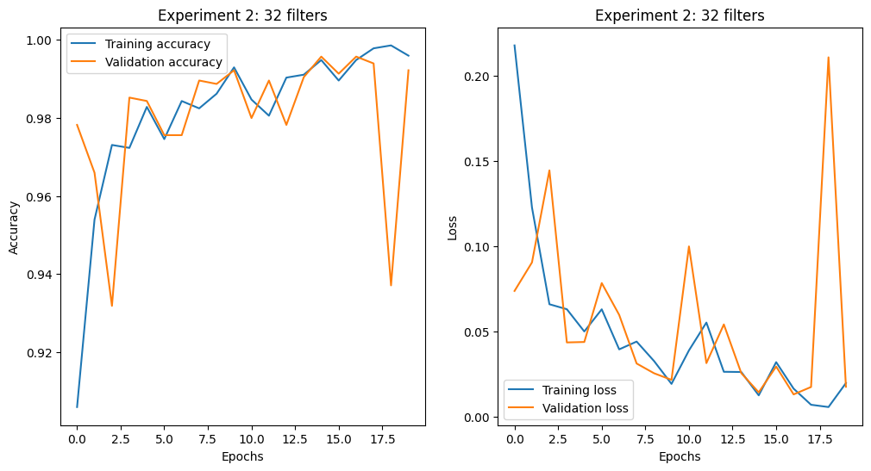
Results

Slide 12
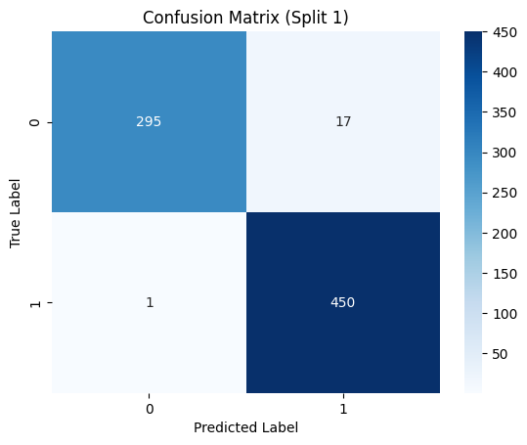
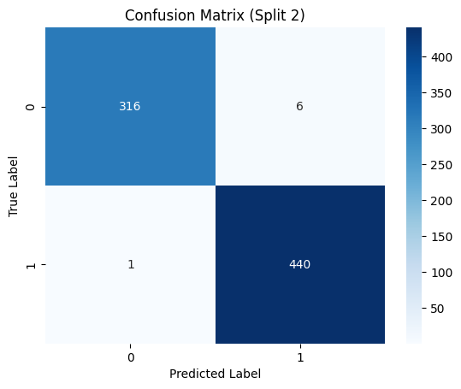


Results

Slide 13
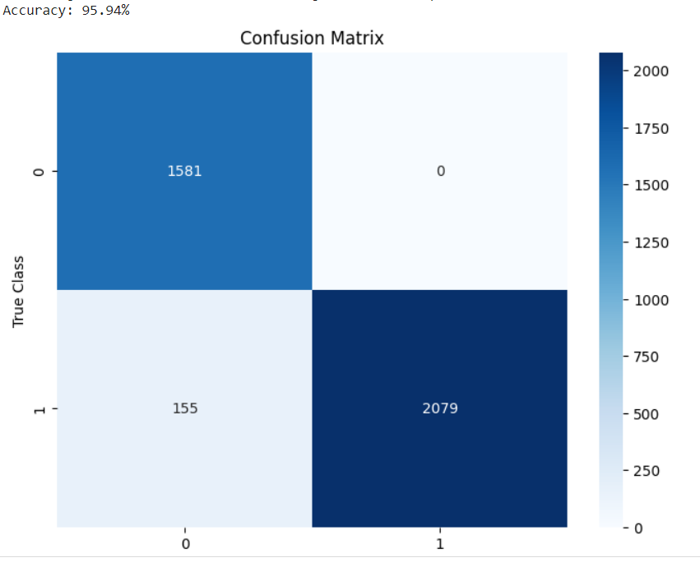
Results
we got a better accuracy of approximately 95% with the model that is trained with data using 32 batches and 5 epochs and 30% of training data.

Slide 14
Future Scope
Learn user’s diet and suggest changes to improve eating habits
Can be used in gardens to remind about watering them
Automatic ordering of generated list from recommended stores by user
Expand Idea to entire pantry, other rooms (study room…unclean desk reminder)

Slide 15
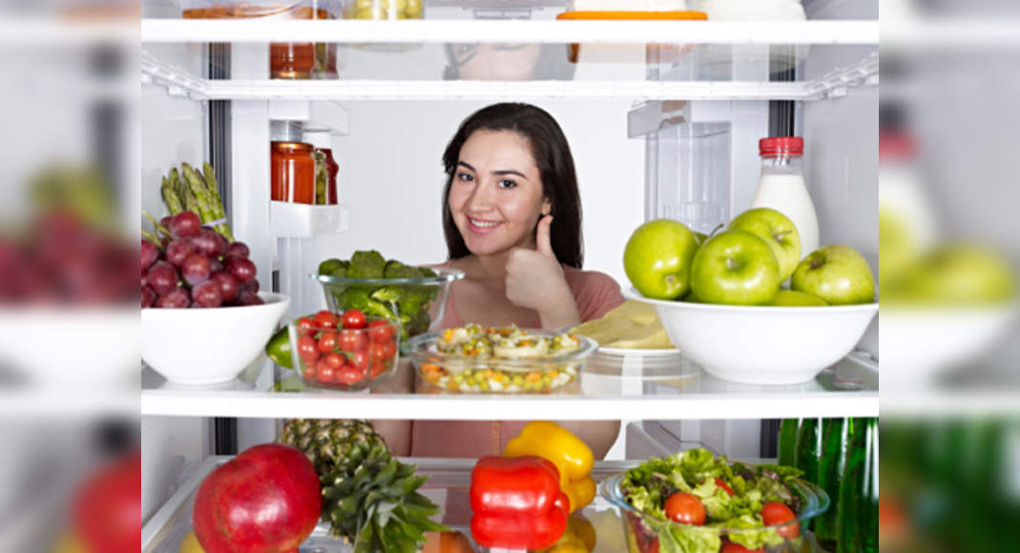
Let’s use this new idea to keep our grocery stock updated and fresh!!
Thank You!!
Stay Hungry, Stay Foolish
Stay Wise, Be Satisfied

